Slide 1
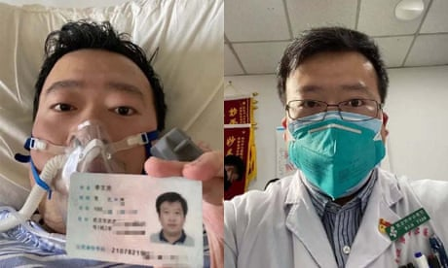
Multimedia project

Slide 2
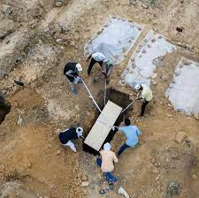
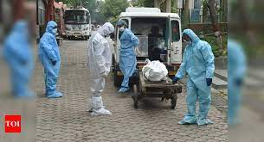
ABSTRACT
GENERAL INFORMATION
The multimedia project designed will help to create awareness towards COVID-19 pandemic that has been a greater challenge to many activities Kenya and worldwide at large.

Slide 3
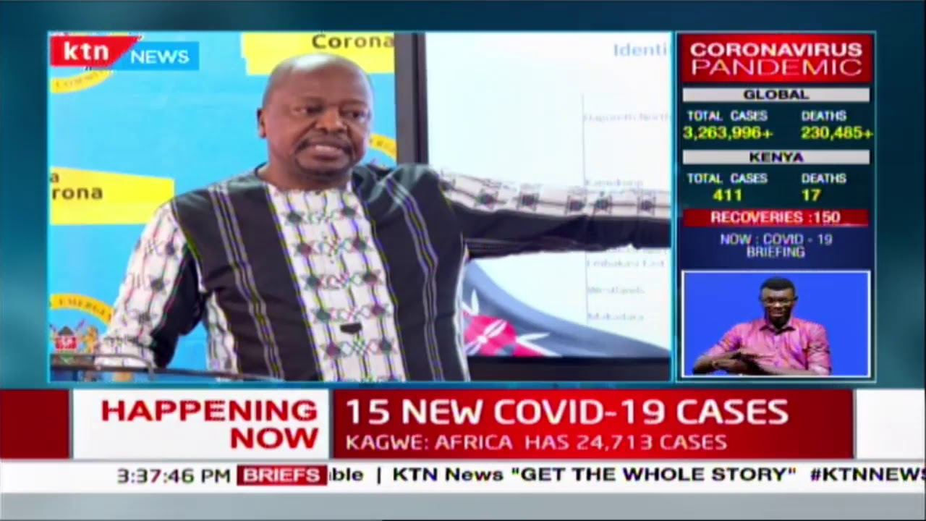
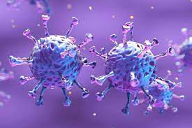
What will the animation achieve
It will educate people on what covid-19 is and its protocol
It will also emphasize on the wearing of face masks and keeping away of people violating the established protocols by WHO

Slide 4
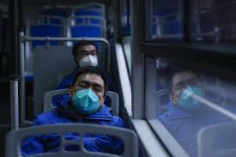
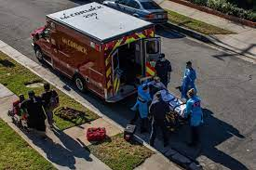
When should the animation used
It should be used 24/7 to educate people to practice measures set to control the spread of COVID-19(coronal ni real)

Slide 5
